Slide 1
Mehran S. Fallah June 2020
Programming Languages
Session XI
ML

Slide 2
Introduction
In the previous session, we introduced a number of important language ideas developed in the Algol family.
We also had a look at some important languages from the Algol family, including Algol 60, Pascal, and C.
In this session, we introduce the ML programming language. ML illustrates most of the important concepts of the Lisp/Algol families of languages.
Type systems have been an important part of programming language design from 1960 to the present day, and the ML type system is often considered the cleanest and most expressive type system to date.
Because most readers are familiar with C and many have not written a lot of programs in significantly different languages, it is useful to have a language other than C to use for examples in our next topics.
ML allows higher-order functions and other constructions that are discussed in the following sessions.
The development of ML has led to many achievements in devising logical frameworks and proof assistants.

Slide 3
ML and Its Origin
ML might be called a mostly functional language with imperative features or perhaps a function-oriented imperative language.
ML has very flexible function features, similar to Lisp, allowing functions to be created in-line as parts of expressions, passed as arguments to functions, and returned as function results.
At the same time, it is possible to write imperative Algol-like programs in a syntax that resembles that of the Algol family with approximately the same degree of ease as for modern descendants of Algol.
ML also has concurrent extensions, making it suitable for developing concurrent systems, and an object-oriented extension. In this course, however, we focus primarily on the core fragment of ML.
One distinguishing feature of ML is its type system, which extends the successful Pascal type system in a number of ways. Unlike C, the ML type system is sound in a precise mathematical sense. Specifically, if the type checker determines that an expression has a certain type, then any terminating evaluation of that expression is guaranteed to produce a legitimate value of that type.

Slide 4

ML and Its Origin (Ctd.)
Before ML, programming languages with sound type systems were generally considered unpleasantly restrictive. Many C programmers have considered it important to “break” the type system in various ways (confusing integers and pointers, for example), and Lisp fans have valued their freedom from static typing.
However, the ML type system is unobtrusive, as many type declarations are automatically deduced by the compiler (type inference or type reconstruction,) and flexible, as the type system allows an expression to have many possible types (polymorphism). We will explore these aspects of the ML type system in more detail in the next session.
As stated earlier, most successful programming languages were originally designed for a single application or a set of closely related programming tasks. The ML programming language was designed by Robin Milner and his associates as part of the LCF project.
The LCF project, aimed at developing a Logic for Computable Functions, drew inspiration from a set of logical principles outlined by Dana Scott. Robin Milner’s goal was to build a system that would make it practical to prove interesting properties of functional programs in an automated or semi-automated manner.

Slide 5
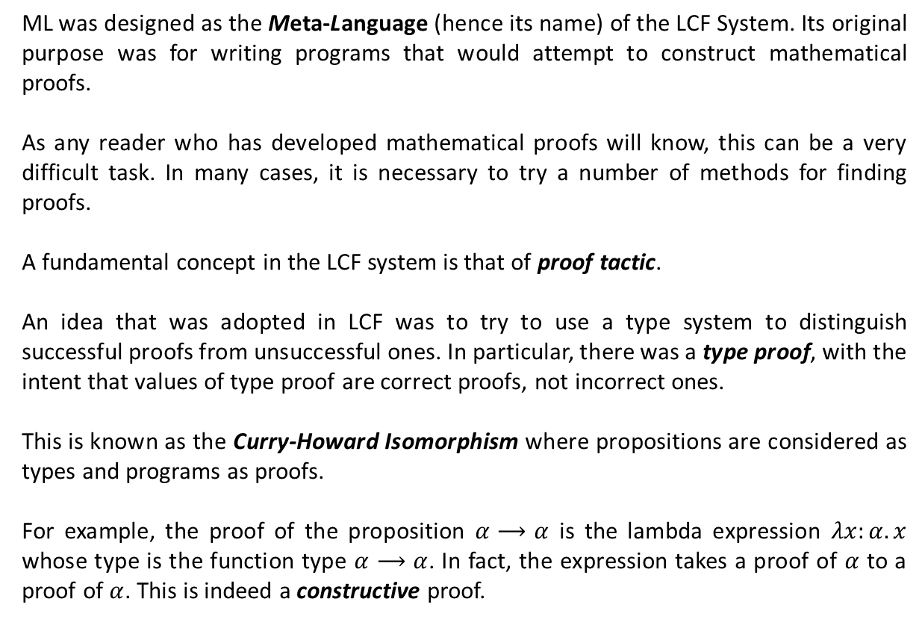
ML and Its Origin (Ctd.)
ML was designed as the Meta-Language (hence its name) of the LCF System. Its original purpose was for writing programs that would attempt to construct mathematical proofs.
As any reader who has developed mathematical proofs will know, this can be a very difficult task. In many cases, it is necessary to try a number of methods for finding proofs.
A fundamental concept in the LCF system is that of proof tactic.
An idea that was adopted in LCF was to try to use a type system to distinguish successful proofs from unsuccessful ones. In particular, there was a type proof, with the intent that values of type proof are correct proofs, not incorrect ones.
This is known as the Curry-Howard Isomorphism where propositions are considered as types and programs as proofs.
For example, the proof of the proposition $α⟶α$ is the lambda expression $λx:α. x$ whose type is the function type $α⟶α$. In fact, the expression takes a proof of $α$ to a proof of $α$. This is indeed a constructive proof.

Slide 6

The ML Programming Language
We study ML in a little more detail than we have studied Algol-like languages. The version of ML that we will use is called Standard ML 97 (SML97). You can also download and install OCaml (an acronym for Objective Categorical Abstract Machine Language) of INRIA on your computer.

Slide 7
The ML Programming Language
Most ML compilers are based on the same kind of read-eval-print loop as many Lisp implementations.
The standard way of interacting with the ML system is to enter expressions and declarations one at a time. As each is entered, the source code is type checked, compiled, and executed.
For expressions, user interaction with the ML compiler has the form
Here are some examples:
-- (5 + 3) - 2;
val it = 6 : int
-- it + 3;
val it = 9 : int
-- if true then 1 else 5;
val it = 1 : int
-- (5 = 4);
val it = false : bool
-- if true then 3 else false;
stdIn:1.1-29.10 Error: types of rules don’t agree [literal]
-- <expression>;
val it = <print value> : <type>

Slide 8
Declaration
User input can be an expression or a declaration. The standard form for ML declarations, followed by compiler output, is
The keyword val stands for value. When a declaration is given to the compiler, the value associated with the identifier is computed and bound to that identifier. Here are some examples:
-- val x=7+2;
val x = 9 : int
-- val y = x+3;
val y = 12 : int
-- val z = x*y - (x div y);
val z = 108 : int
Functions can be declared with the keyword fun (which stands for function) instead of val. The general form of user input and compiler output is
Here is an example:
-- fun f(x) = x + 5;
val f = fn : int -> int
-- val <identifier> = <expression>;
val <identifier> = <print value> : <type>
-- fun <identifier>(<arguments>) = <expression>;
val <identifier> = fn : <arg type> -> <result type>

Slide 9
Declaration (Ctd.)
The same function can be declared by a val declaration, written as
-- val f = fn x => x+5;
val f = fn : int -> int
In this declaration, the identifier f is given the value of expression fn x => x+5, which is a function expression like (lambda (x) (+ x 5)) in Lisp or λx. x + 5 in the lambda-calculus.
An important aspect of ML is that the value of an identifier cannot be changed by assignment. More specifically, if an identifier x is declared by val x = 3, for example, then the value of x will always be 3. It is not possible to change the value of x by assignment.
The way to declare an assignable variable in ML is to define a reference cell.
Although you may initially think otherwise, the ML treatment of identifiers and variables is more uniform than the treatment of identifiers and variables in languages such as Pascal and C. If an integer identifier is declared in C or Pascal, it is treated as an assignable variable. On the other hand, if a function is declared and given a name in either of these languages, the name of the function is a constant, not a variable. It is not possible to assign to the function name and change it to a different function. In ML, a val declaration works the same way for all types of values.

Slide 10
Basic Types
The type unit has only one element, written as empty parentheses:
Like void in C, unit is used as the result type for functions that are executed only for side effects. The type unit is also used as the type of argument for functions that have no arguments.
There are two values of type bool, true and false:
The most common expression form associated with Booleans is conditional, with
There are also ML Boolean operations for conjunction, disjunction, negation, and so on. Negation is written as not, conjunction (and) is written as andalso and disjunction (or) is written as orelse. For example, here is a function that determines whether its two arguments have the same Boolean value, followed by an expression that calls this function:
( ) : unit
true : bool
false : bool
if e1 then e2 else e3
-- fun equiv(x,y) = (x andalso y) orelse ((not x) andalso (not y));
val equiv = fn : bool * bool -> bool
-- equiv(true,false);
val it = false : bool

Slide 11
Basic Types (Ctd.)
Many ML integer expressions are written in the usual way, with number constants and standard arithmetic operations:
The operator div is a binary infix operator on integers, used as follows:
Strings are written as a sequence of symbols between double quotes:
“William Jefferson Clinton” : string
“Boris Yeltsin” : string
String concatenation is written as ^, so we have
-- “Chelsey” ^ “ ” ^ “Clinton”;
val it = “Chelsey Clinton” : string
The ML type for floating-point numbers is real. For reasons that will be easier to understand when we come to type inference, ML requires a decimal point in real constants:
1.0, 2.0, 3.14159, 4.44444, . . . : real
The arithmetic operators +, -, and * may be applied to either integers or real numbers.
-- 3+4;
val it = 7 : int
-- 4.0 + 5.1;
val it = 9.1 : real
0,1,2, . . . ,-1,-2, . . . : int
+, -, *, div : int * int -> int
-- fun quotient(x,y) = x div y;
val quotient = fn : int * int –> int

Slide 12
Type Constructors
A tuple may be a pair, triple, quadruple, and so on. In ML, tuples may be formed of any types of values. Tuple values are written with parentheses and tuple types are written with *. For example, here is the compiler output for a pair, a triple, and a quadruple:
-- (3,4);
val it = (3,4) : int * int
-- (4,5,true);
val it = (4,5,true) : int * int * bool
-- (“Bob”, “Carol”, “Ted”, “Alice”);
val it = (“Bob”,“Carol”,“Ted”,“Alice”) : string * string * string * string
Components of a tuple are accessed by functions that name the position of the desired component. For example, #i, selects the ith component of any tuple.
-- #2(3,4);
val it = 4 : int
-- #3(“John”, “Paul”, “George”, “Ringo”);
val it = “George” : string
Like Pascal records and C structs, ML records are similar to tuples, but with named components. Record values and record types are written with curly braces.
-- {First name = “Donald”, Last name = “Knuth”};
val it = {First name=“Donald”, Last name=“Knuth”}
: {First name:string, Last name:string}

Slide 13
Type Constructors (Ctd.)
The expression {First name = “Donald”, Last name = “Knuth”} has two components, one called First name and the other called Last name. Record components can be accessed with # functions.
-- #First name({First name=“Donald”, Last name=“Knuth”});
val it = “Donald” : string
ML lists can have any length, but all elements of a list must have the same type. We can write lists by listing their elements, separated by commas, between brackets.
-- [1,2,3,4];
val it = [1,2,3,4] : int list
-- [true, false];
val it = [true,false] : bool list
-- [“red”, “yellow”, “blue”];
val it = [“red”,“yellow”,“blue”] : string list
-- [ fn x => x+1, fn x => x+2];
val it = [fn,fn] : (int -> int) list
As in Lisp, the empty list is written nil in ML. List cons is an infix operator written as a pair of colons:
-- 3 :: nil;
val it = [3] : int list
-- 4 :: 5 :: it;
val it = [4,5,3] : int list

Slide 14
Patterns and Pattern Matching
The declarations we have seen so far bind a value to a single identifier. One very convenient syntactic feature of ML is that declarations can also bind values to a set of identifiers by using patterns.
A pattern is an expression containing variables (such as x, y, z) and constants (such as true, false, 1, 2, 3), combined by certain forms such as tupling, record expressions, and a form of operation called a constructor.
The general form of value declaration is
where the common forms of patterns are summarized by the following grammar:
In words, a pattern can be an identifier, a tuple pattern, a list cons pattern, a record pattern, or a declared data-type constructor pattern.
val <pattern> = <exp>;
<pattern> ::= <id> | <tuple> | <cons> | <record> | <constr>
<tuple> ::= (<pattern>, . . . , <pattern>)
<cons> ::= <pattern>::<pattern>
<record> ::= {<id>=<pattern>, . . . , <id>=<pattern>}
<constr> ::= <id>(<pattern>, . . . , <pattern>)

Slide 15
Patterns and Pattern Matching (Ctd.)
Because a variable is a pattern, a value declaration can simply associate a value with a variable. For example,
-- val t = (1,2,3);
val t = (1,2,3) : int * int * int
-- val (x,y,z) = t;
val x = 1 : int
val y = 2 : int
val z = 3 : int
In the second declaration, the tuple pattern (x,y,z) is given the value of t. When the pattern (x,y,z)is matched against the triple t, identifier x gets value 1, identifier y gets value 2, and identifier z gets value 3.
The general form of a function declaration uses patterns. A single-clause definition has the form
and a multiple-clause definition has the form
For example, a function adding its arguments can be written as
fun f(x,y) = x + y;
fun f(<pattern>) = <exp>;
fun f(<pattern1>) = <exp1> | . . . | f(<patternn>) = <expn>;

Slide 16
Patterns and Pattern Matching (Ctd.)
Consider the function declaration
fun f(x,y) = x + y;
Technically, the formal parameter of this function is a pattern (x,y) that must match the actual parameter on a call to f. The formal parameter to f is a tuple, which is broken down by pattern matching into its first and second components. In reality, you are calling a function of one argument. That argument happens to be a pair of values. Pattern matching takes the tuple apart, binding x to what you might think is the first parameter and y to the second.
An example in which more than one clause is used is the following function, which computes the length of a list:
-- fun length(nil) = 0
| length( x :: xs ) = 1 + length(xs);
val length = fn : ’a list -> int
Here is an example application of length and the resulting value:
-- length [“a”, “b”, “c”, “d”];
val it = 4 : int
When the function length is applied to an argument, the clauses are matched in the order they are written. If the argument matches the constant nil, then the function returns the value 0, as specified by the first clause. Otherwise the argument is matched against the pattern (x::xs) given in the second clause.

Slide 17
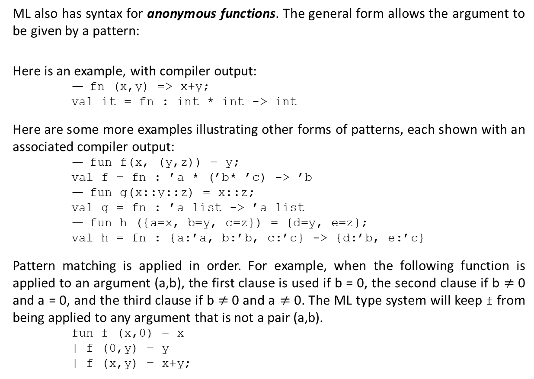
Patterns and Pattern Matching (Ctd.)
ML also has syntax for anonymous functions. The general form allows the argument to be given by a pattern:
Here is an example, with compiler output:
-- fn (x,y) => x+y;
val it = fn : int * int -> int
Here are some more examples illustrating other forms of patterns, each shown with an associated compiler output:
-- fun f(x, (y,z)) = y;
val f = fn : ’a * (’b* ’c) -> ’b
-- fun g(x::y::z) = x::z;
val g = fn : ’a list -> ’a list
-- fun h ({a=x, b=y, c=z}) = {d=y, e=z};
val h = fn : {a:’a, b:’b, c:’c} -> {d:’b, e:’c}
Pattern matching is applied in order. For example, when the following function is applied to an argument (a,b), the first clause is used if b = 0, the second clause if b $≠$ 0 and a = 0, and the third clause if b $≠$0 and a $≠$ 0. The ML type system will keep f from being applied to any argument that is not a pair (a,b).
fun f (x,0) = x
| f (0,y) = y
| f (x,y) = x+y;
fn (<pattern>) => <exp>;

Slide 18
Data-Type Declaration
The ML data-type declaration is a special form of type declaration that declares a type name and operations for building and making use of elements of the type. The ML data-type declaration has the syntactic form
where a constructor clause has the form
The idea is that each constructor clause tells one way to construct elements of the type. Elements of the type may be deconstructed into their constituent parts by pattern matching.
Example 1 (An Enumerated Data Type.) Types consisting of a finite set of tokens can be declared as ML data types. Here is a type consisting of three tokens, named to indicate three specific colors:
-- datatype color = Red | Blue | Green;
datatype color = Blue | Green | Red
The compiler output, which looks just like the ML input code, indicates that the three elements of type color are Blue, Green, and Red. Technically, values Blue, Green, and Red are called constructors. They are called constructors because they are the ways of constructing values with type color.
datatype <type name> = <constructor clause> | $⋯$ | <constructor clause>
<constructor clause> ::= <constructor> | <constructor> of <arg types>

Slide 19
Data-Type Declaration (Ctd.)
Example 2 (A Tagged Union Data Type.) Constructors do not actually do anything to their arguments, other than to tag their arguments so that values constructed in different ways can be distinguished by pattern matching. Suppose we are keeping student records, with names of B.S. students, names and undergraduate institutions of M.S. students, and names and faculty supervisors of Ph.D. students. Then we could define a type student that allows these three forms of tuples as follows:
-- datatype student = BS of name | MS of name*school
| PhD of name*faculty;
In effect, the type student is the union of three types,
student ≈ union {name, name*school, name*faculty }
except that in ML “unions” (which are defined by datatype), each value of the union is tagged by a constructor that tells which of the constituent types the value comes from (sum and variant typing.) This is illustrated in the following function, which returns the name of a student:
-- fun name(BS(n)) = n
| name(MS(n,s)) = n
| name(PhD(n,f)) = n;
val name = fn : student -> name

Slide 20
Data-Type Declaration (Ctd.)
Example 3 (A Recursive Type.) Data-type declaration may be recursive in that the type name may appear in one or more of the constructor argument types. The set of trees with integer labels at the leaves may be defined mathematically as follows:
This definition can be expressed as the following ML data-type declaration
datatype tree = LEAF of int | NODE of (tree * tree);
The identifiers LEAF and NODE are constructors, and the elements of the data type are all values that can be produced by the application of constructors to legal (type-correct)
arguments. The following function shows how the constructors may be used to define a function on trees:
-- fun inTree(x, LEAF(y)) = x = y
| inTree(x, NODE(y,z)) = inTree(x, y) orelse inTree(x,z);
val inTree = fn : int * tree -> bool
This function looks for a specific integer value x in a tree.
A tree is either a leaf, with an associated integer label, or a compound tree, consisting of a left subtree and a right subtree.

Slide 21
Reference Cells and Assignment
None of the ML constructs discussed so far have side effects.
Although most ML programs are written in a style that avoids side effects when possible, most large ML programs do use assignment occasionally to change the value of a variable.
The way that assignable variables are presented in ML is different from the way that assignable variables appear in other programming languages.
The main reasons for this are to preserve the uniformity of ML as a programming language and to separate side effects from pure expressions as much as possible.
ML assignment is restricted to reference cells. In ML, a reference cell has a different type than immutable values such as integers, strings, lists, and so on.
Because reference cells have specific reference types, restrictions on ML assignment are enforced as part of the type system. This is part of the elegance of ML: Almost all restrictions on the structure of programs are part of the type system.
Before looking at assignment in ML, let us think about the difference between memory locations and their contents.

Slide 22
Reference Cells and Assignment (Ctd.)
The following pseudocode fragment illustrates the idea:
x : int;
y : int;
x := y + 3;
The central point is that the two variables x and y are used differently. The assignment command uses only the value stored in y and does not depend on the location of y. In contrast, the command uses the location of x, but does not depend on the value stored in x before the assignment occurs.
The location of a variable is called its L-value, and the value stored in this location is called the R-value of the variable.
In ML, L-values and R-values have different types. In other words, an assignable region of memory has a different type than a value that cannot be changed.
In ML, an L-value, or assignable region of memory, is called a reference cell. The type of a reference cell indicates that it is a reference cell and specifies the type of value that it contains.
For example, a reference cell that contains an integer has type int ref, meaning an integer reference cell.

Slide 23
Reference Cells and Assignment (Ctd.)
When a reference cell is created, it must be initialized to a value of the correct type. Therefore ML does not have uninitialized variables or dangling pointers.
When an assignment changes the value stored in a reference cell, the assignment must be consistent with the type of the reference cell: An integer reference cell will always contain an integer, a list reference cell will always contain (or refer to) a list, and so on.
ML has operations to create reference cells, to access their contents, and to change their contents. These are ref, !, and :=, which behave as follows:
ref v creates a reference cell containing value v
!r returns the value contained in reference cell r
r := v places value v in reference cell r
Here are some examples:
-- val x = ref 0;
val x = ref 0 : int ref
-- x := 3*(!x) + 5;
val it = () : unit
-- !x;
val it = 5 : int

Slide 24
Reference Cells and Assignment (Ctd.)
Because ML does not have any operations for computing the address of a value, there is no way to observe whether assignment is by value or by pointer. As a result, it is a convenient and accurate abstraction to regard a reference cell as a box holding a value of any size and to regard assignment as an operation that places a value inside the box.
Because reference cells can be created for any type of value, we can define a string reference cell and change its contents by assignment:
-- val y = ref “Apple”;
val y = ref “Apple” : string ref
-- y := “Fried green tomatoes”;
val it = () : unit
-- !y;
val it = “Fried green tomatoes” : string
As you know, different strings may require different amounts of memory. Therefore, it does not seem likely that the memory cell bound to y can hold any string of any length.
x
x := 5;
x
0
5
y
y := “Fried …;
y
Apple
Fried green tomatoes

Slide 25
Reference Cells and Assignment (Ctd.)
Here is one last simple code example to show how ML reference cells may be used in an iterative loop. This loop sums the numbers between 1 and 10:
val i = ref 0;
val j = ref 0;
while !i < 10 do (i := !i + 1; j := !j + !i);
!j;
As illustrated in this example, two imperative expressions can be combined with a semicolon.
In fact, a semicolon can be used to combine any two expressions. The expression
e1; e2
is equivalent to
(fn x => e2) e1
where x is chosen not to appear in e2. As a result, the value of e1; e2 is the value of
e2 after e1 has been evaluated.

Slide 26
Concepts in Programming Languages (Chapter 5)
Please see Assignment 5 at https://courses.aut.ac.ir.

